Slide 1
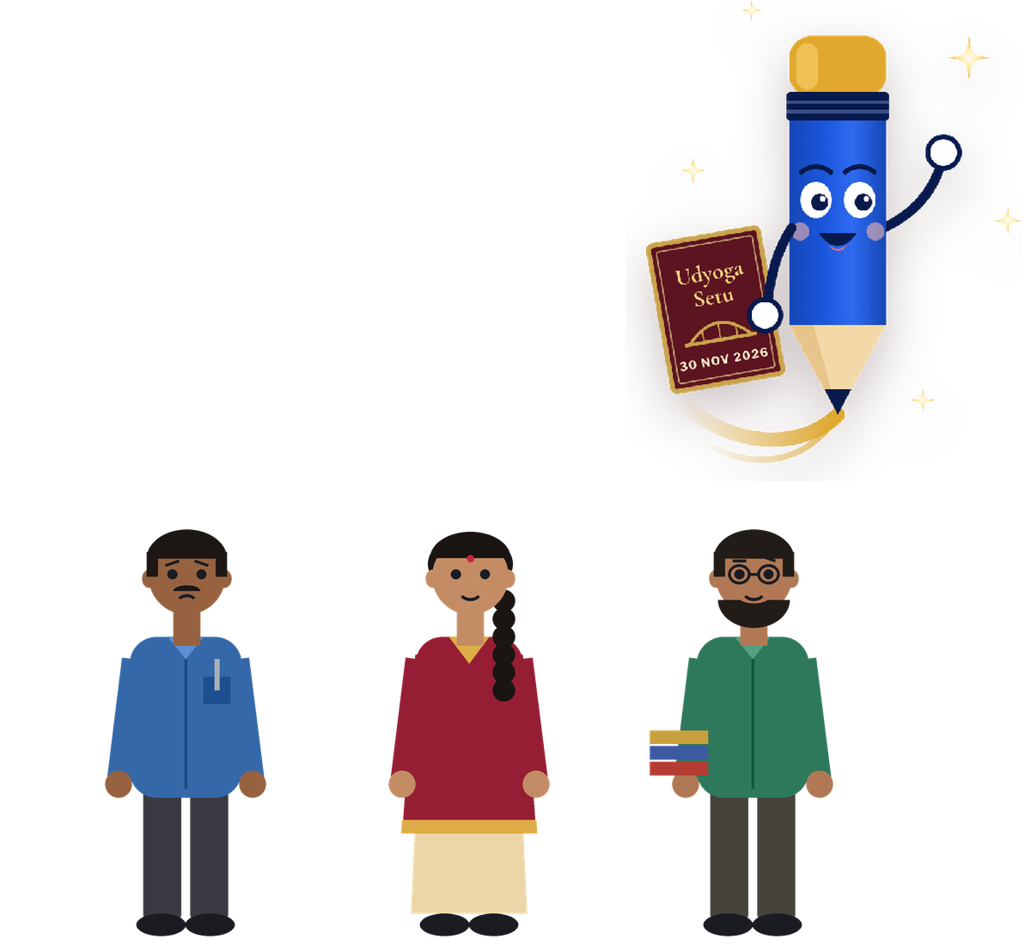
SESSION 1 OF 6 · 18 OCT 2026 · 10 AM – 1 PM
Orientation & Registration
ಪರಿಚಯ ಮತ್ತು ನೋಂದಣಿ
Nobody owes you a job.
ಕೆಲಸ ಯಾರೂ ಕೊಡುವುದಿಲ್ಲ — ನಾವೇ ಗಳಿಸಬೇಕು.
KKCCI Building, 2nd Floor, Kalaburagi · Job Mela: Mon 30 Nov 2026, MRMC SAC Building
100% FREE
for all job seekers
Cross the bridge to your career. · ನಿಮ್ಮ ವೃತ್ತಿಜೀವನಕ್ಕೆ ಸೇತುವೆ ದಾಟಿ
Notes:
10:00 · 5 min
DO: Welcome. No lecture tone — speak like an elder brother. Introduce Udyoga Setu in 3 lines: 6 sessions, Job Mela on 30 Nov, 100% free.
KEY POINTS:
- This is not a class. Nobody will teach you here. You will think, argue and decide.
- Today's one idea: nobody owes you a job — and that is good news.
ಕನ್ನಡ: ಇದು ಕ್ಲಾಸ್ ಅಲ್ಲ. ಇಲ್ಲಿ ನೀವೇ ಯೋಚಿಸಿ, ನೀವೇ ನಿರ್ಧರಿಸಿ.

Slide 2
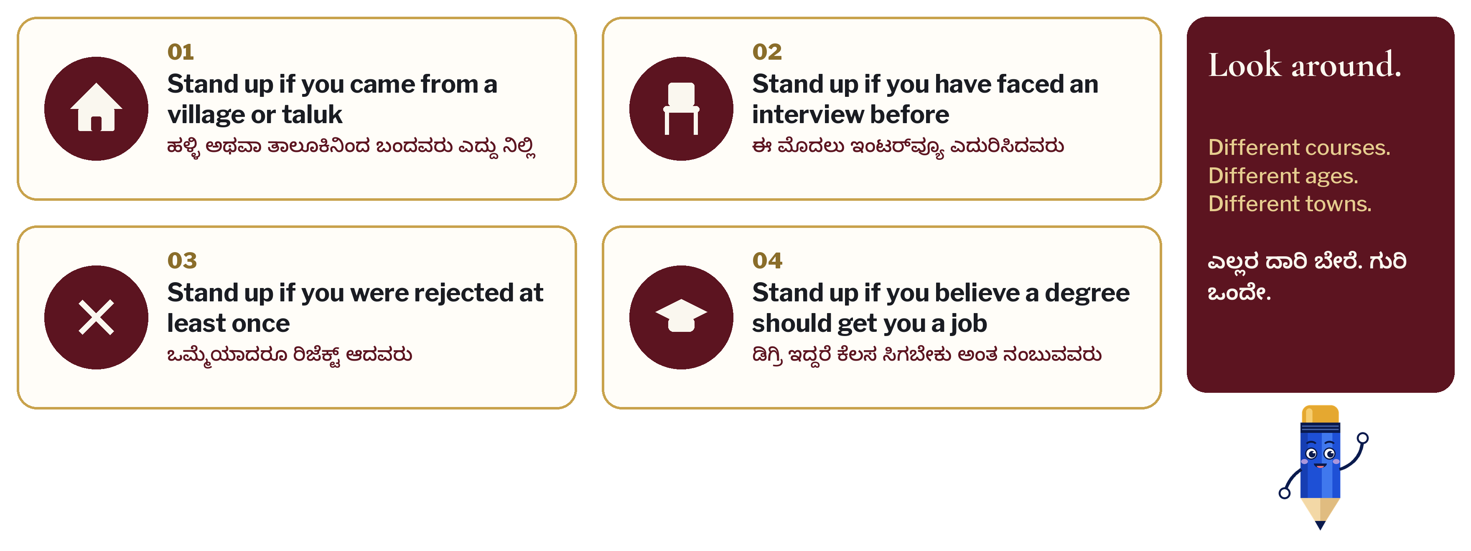
Stand up if…
ಹೀಗಿದ್ದರೆ ಎದ್ದು ನಿಲ್ಲಿ…
Notes:
10:05 · 10 min
DO: Read each line. People stand, look around, sit. Pause 5 seconds on each so they see each other.
KEY POINTS:
- Look around: different courses, ages, towns. Same goal.
- Line 4 is the trap. Remember how many stood up for it — we come back to it.
ASK: Who stood up for all four?
ಕನ್ನಡ: ಸುತ್ತ ನೋಡಿ. ಎಲ್ಲರ ದಾರಿ ಬೇರೆ, ಗುರಿ ಒಂದೇ.

Slide 3
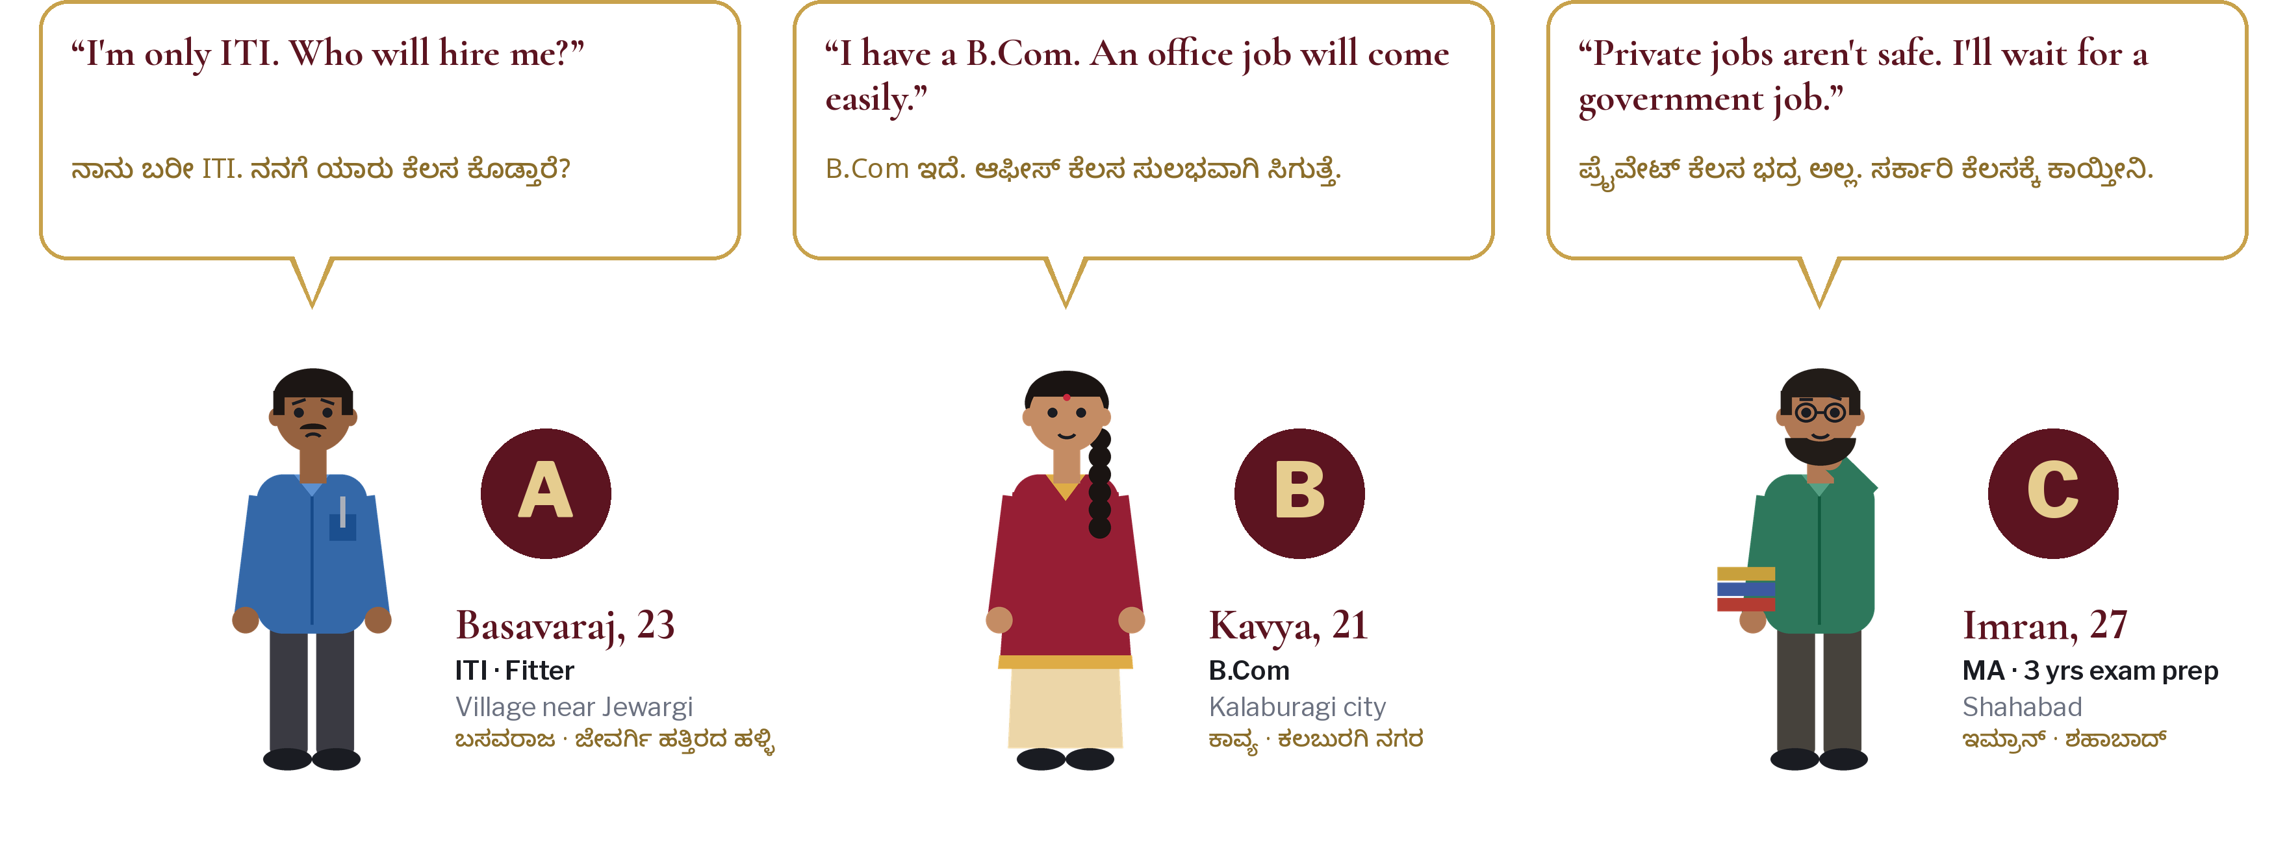
Who is right?
ಇವರಲ್ಲಿ ಯಾರು ಸರಿ?
Notes:
10:15 · 15 min
DO: Introduce the three characters as real people from our district. Vote: raise hands for A, B, C, or 'none of them'. Ask 2 people from each side why.
KEY POINTS:
- Basavaraj undervalues himself. Kavya overvalues the degree. Imran is waiting while life moves.
- Each is half right. We will follow these three for all six sessions.
ASK: Who are YOU most like — A, B or C?
ಕನ್ನಡ: ನೀವು ಇವರಲ್ಲಿ ಯಾರಂತೆ ಇದ್ದೀರಿ?

Slide 4

Watch: one minute of truth
ಒಂದು ನಿಮಿಷದ ಸತ್ಯ — ನೋಡಿ
AFTER THE VIDEO
Which line hit you hardest?
ಯಾವ ಸಾಲು ನಿಮ್ಮ ಮನಸ್ಸಿಗೆ ತಾಗಿತು?
Click the video to play · ವಿಡಿಯೋ ಕ್ಲಿಕ್ ಮಾಡಿ
Notes:
10:30 · 5 min
DO: Play the video (54 s). Full screen. Then silence for 5 seconds before speaking.
KEY POINTS:
- Which line hit you hardest?
ASK: One word: how did that make you feel?
ಕನ್ನಡ: ಯಾವ ಸಾಲು ನಿಮ್ಮ ಮನಸ್ಸಿಗೆ ತಾಗಿತು?

Slide 5
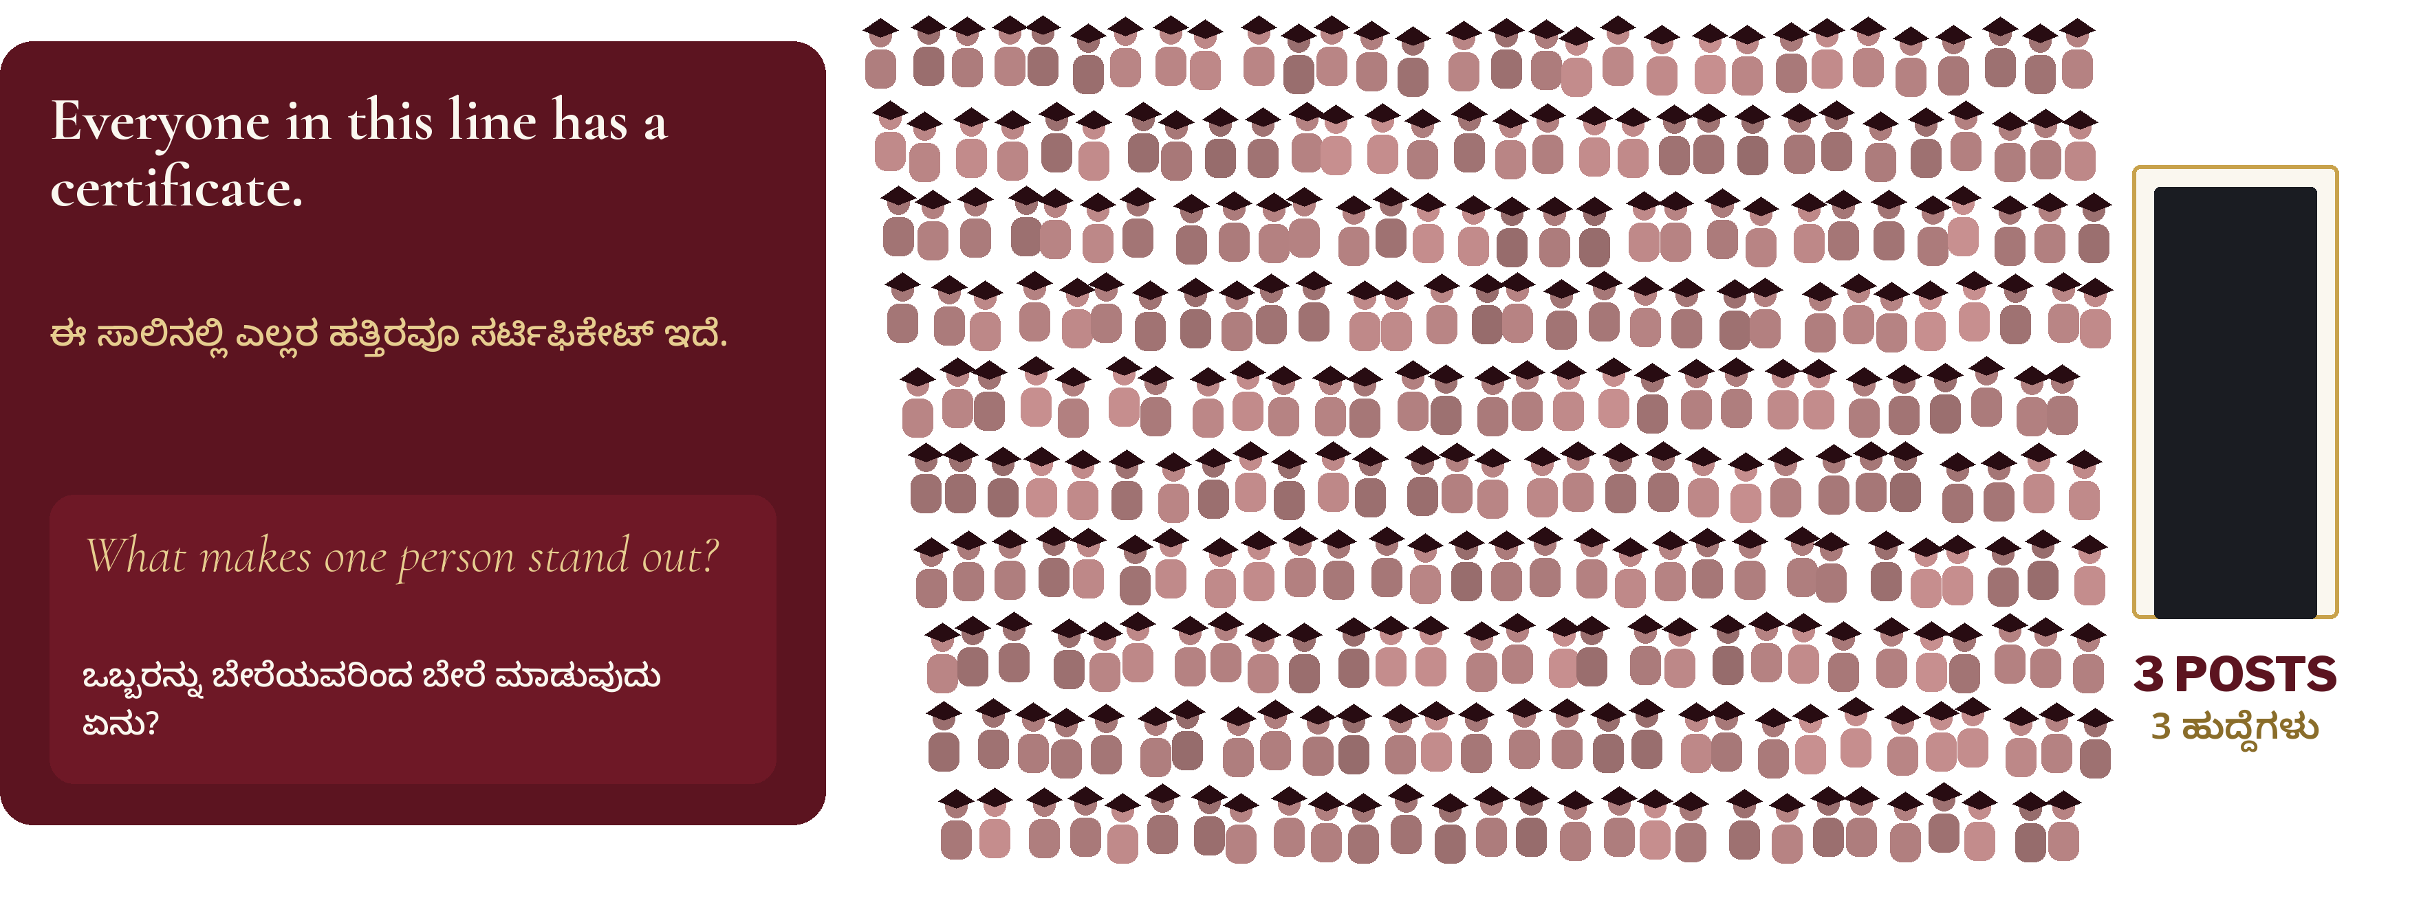
3 posts. Thousands of certificates.
3 ಹುದ್ದೆ. ಸಾವಿರಾರು ಸರ್ಟಿಫಿಕೇಟ್‌ಗಳು.
Notes:
10:35 · 15 min
DO: Pairs: turn to the person next to you (ideally a stranger). 3 minutes: what would make ONE person in that line stand out? Collect 5 answers aloud.
KEY POINTS:
- Answers usually: marks, English, recommendation. Push back: what would the employer see in 10 minutes?
- Land it: being useful, being reliable, showing proof.
ASK: What would make you the one who walks through that door?
ಕನ್ನಡ: ಆ ಬಾಗಿಲಿನಿಂದ ಒಳಗೆ ಹೋಗುವವರು ನೀವೇ ಆಗಲು ಏನು ಬೇಕು?

Slide 6
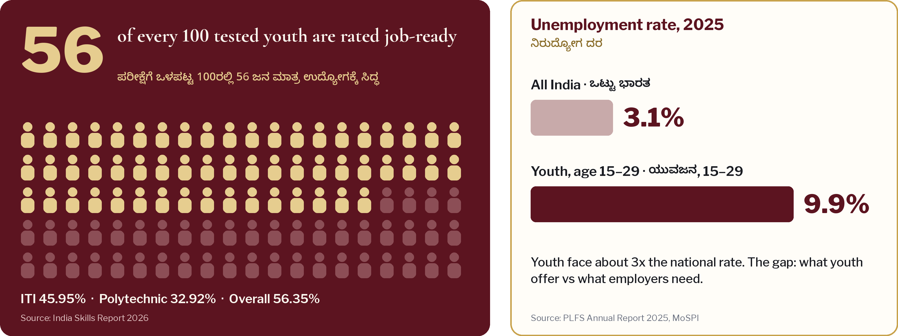
The hard numbers
ಕಟು ಸತ್ಯದ ಅಂಕಿಅಂಶಗಳು
Notes:
10:50 · 10 min
DO: Read the two numbers slowly. Do not soften them. Then say the good news.
KEY POINTS:
- 56 of 100 tested youth are rated job-ready. ITI 46, polytechnic 33.
- Youth unemployment is about 3x the national rate.
- Good news: job-readiness can be built in weeks, not years. That is what these six sessions are for.
ASK: Which side of the 56 do you think you are on today?
ಕನ್ನಡ: ನೀವು ಈ 56ರಲ್ಲಿ ಇದ್ದೀರಾ?

Slide 7
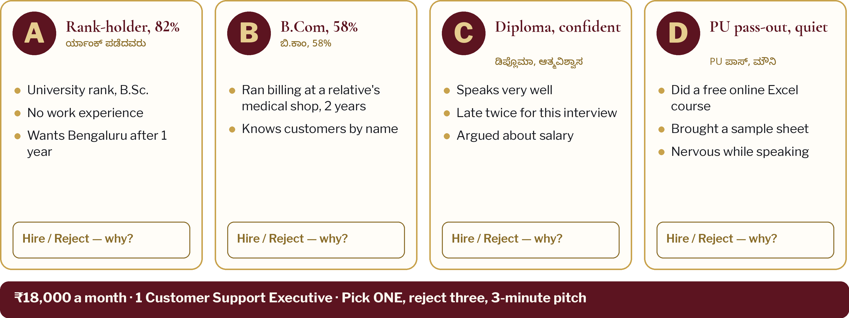
You are the employer
ಈಗ ನೀವೇ ಕಂಪನಿ ಮಾಲೀಕರು
Notes:
11:00 · 40 min
DO: Form teams of 6–8: count off 1 to 8 across rows so courses and towns mix. Each team names itself like a company. Roles: Manager, Timekeeper, Recorder, Presenter. 15 min to decide, then 3-min pitch per team.
KEY POINTS:
- You have ₹18,000 a month of your own money. Hire one, reject three.
- Most teams reject the topper and pick B or D. Ask why — that is the lesson.
- Now look at your own profile through the same eyes.
ASK: Which candidate are you most like today? What would an employer reject in you?
ಕನ್ನಡ: ನಿಮ್ಮ ಪ್ರೊಫೈಲ್ ನೋಡಿ ಕಂಪನಿ ಏನನ್ನು ರಿಜೆಕ್ಟ್ ಮಾಡಬಹುದು?

Slide 8
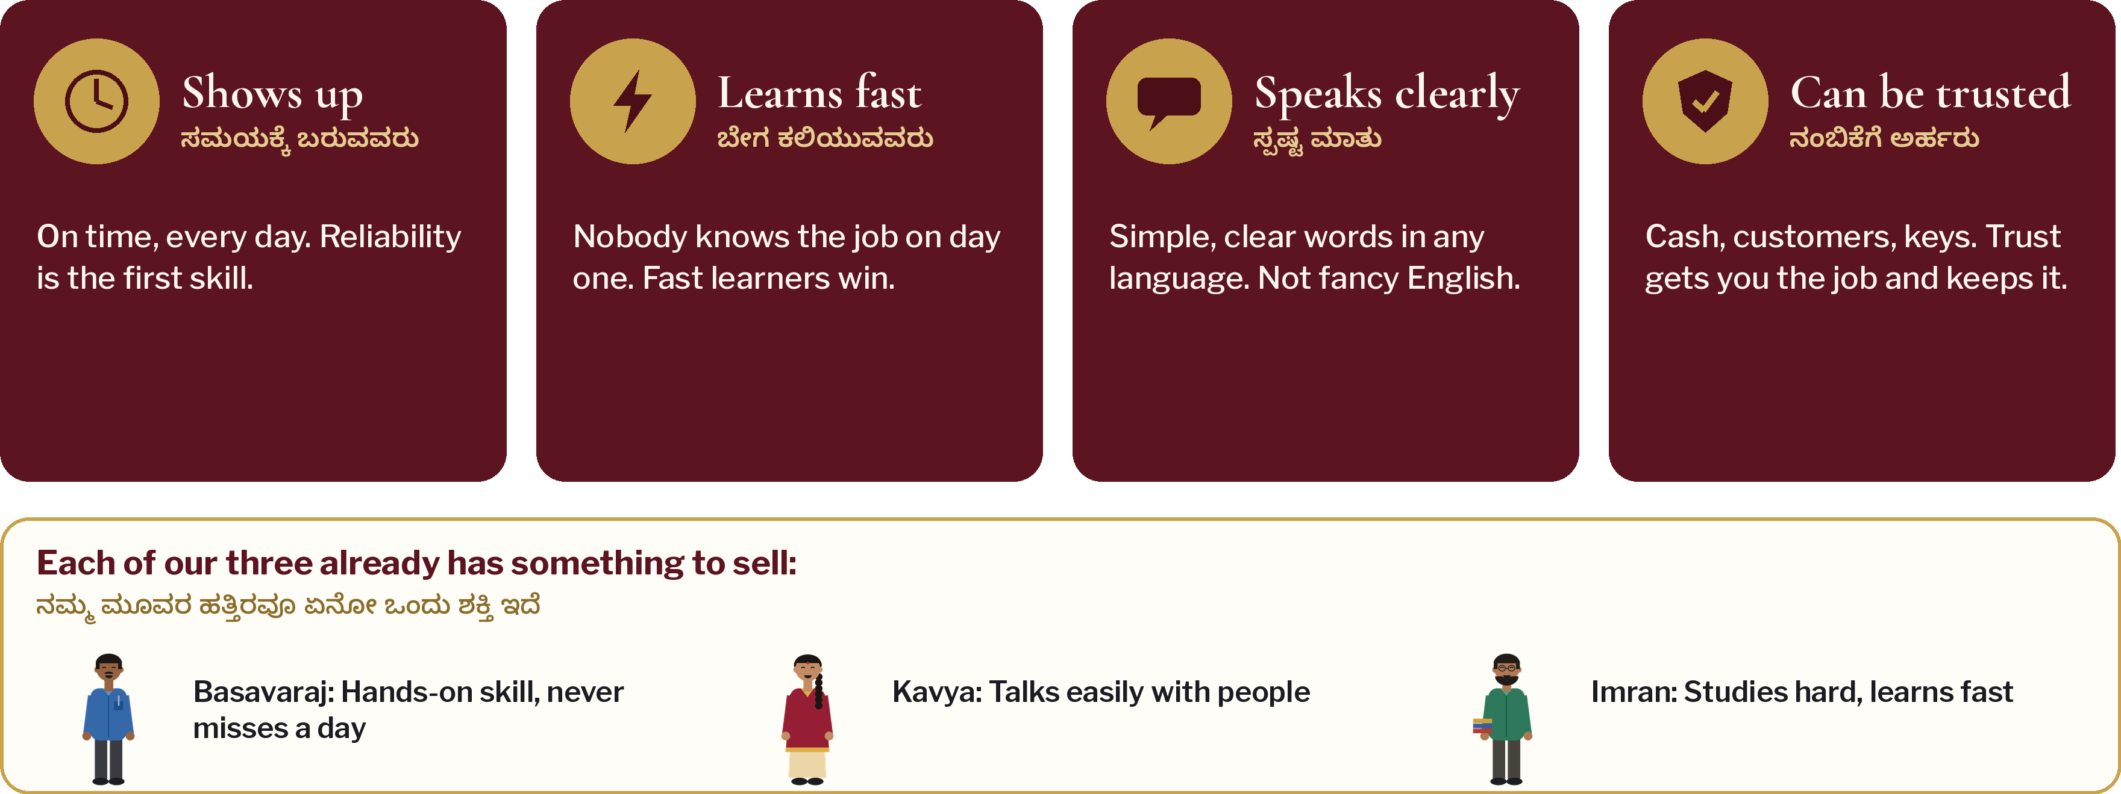
What employers really pay for
ಕಂಪನಿಗಳು ನಿಜವಾಗಿ ಸಂಬಳ ಕೊಡುವುದು ಇದಕ್ಕೆ
Notes:
11:50 · 15 min
DO: Reveal the four things. For each, ask for a hand-raise: 'Who can prove this today?'
KEY POINTS:
- Shows up · learns fast · speaks clearly · can be trusted.
- None of these needs a high percentage. All of them need proof.
- Basavaraj never misses a day. Kavya talks easily. Imran learns fast. Everyone has something to sell.
ASK: Which one of the four is your strongest? Which is weakest?
ಕನ್ನಡ: ಈ ನಾಲ್ಕರಲ್ಲಿ ನಿಮ್ಮ ಶಕ್ತಿ ಯಾವುದು?

Slide 9
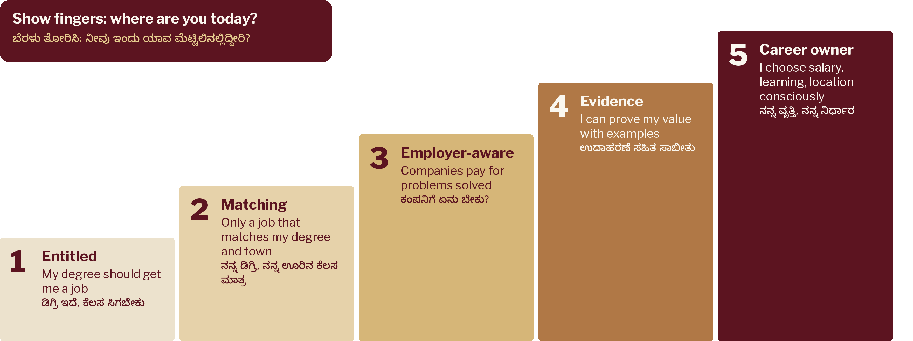
The Thinking Ladder
ಯೋಚನೆಯ ಏಣಿ
Notes:
12:05 · 10 min
DO: Everyone shows 1–5 fingers: where is your thinking today? Note the room's average. We will measure again on 22 Nov.
KEY POINTS:
- Goal of every session: climb one step. 40% to 60%. 70% to 90%.
- Step 1 people are not bad — they were simply never told.
ASK: What would move you one step up by next Sunday?
ಕನ್ನಡ: ಮುಂದಿನ ಭಾನುವಾರದೊಳಗೆ ಒಂದು ಮೆಟ್ಟಿಲು ಮೇಲೆ ಹೋಗಲು ಏನು ಮಾಡುತ್ತೀರಿ?

Slide 10
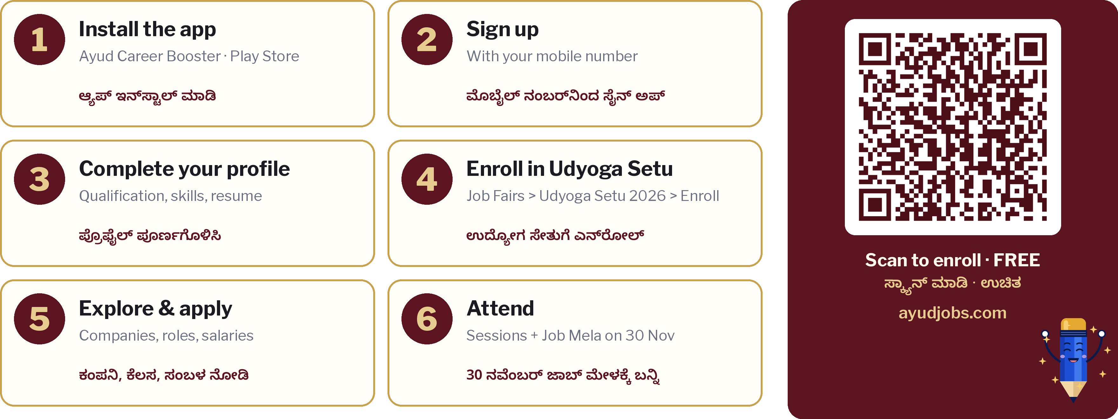
Enroll in Udyoga Setu in 6 steps
6 ಹೆಜ್ಜೆಯಲ್ಲಿ ಉದ್ಯೋಗ ಸೇತುಗೆ ಎನ್‌ರೋಲ್ ಮಾಡಿ
Notes:
12:15 · 30 min
DO: Enrollment on the spot. Volunteers walk the rows. Rule: nobody leaves without the ENROLL button pressed. Those without data: pair with a friend.
KEY POINTS:
- This is your first proof of 'shows up' and 'learns fast'.
- Pre-registered candidates get fast-track entry on 30 Nov.
ASK: Show me your phone screen when it says Enrolled.
ಕನ್ನಡ: ಎನ್‌ರೋಲ್ ಆದ ಮೇಲೆ ಸ್ಕ್ರೀನ್ ತೋರಿಸಿ.

Slide 11
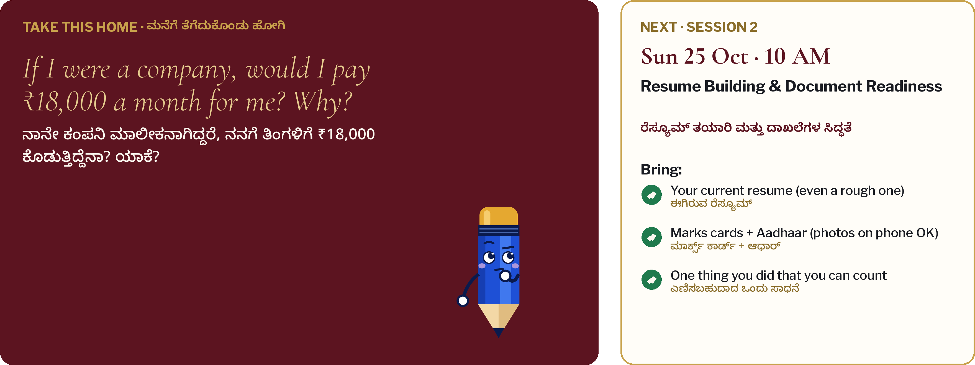
Take this home
ಮನೆಗೆ ತೆಗೆದುಕೊಂಡು ಹೋಗಿ
Notes:
12:45 · 10 min
DO: Read the question twice. Ask them to write one line on their phone notes tonight. Tell them what to bring next Sunday.
KEY POINTS:
- Next Sunday we turn your answer into a resume line that an employer cannot ignore.
ASK: If I were a company, would I pay ₹18,000 a month for me? Why?
ಕನ್ನಡ: ನಾನೇ ಕಂಪನಿ ಆಗಿದ್ದರೆ, ನನಗೆ ₹18,000 ಕೊಡುತ್ತಿದ್ದೆನಾ?

Slide 12
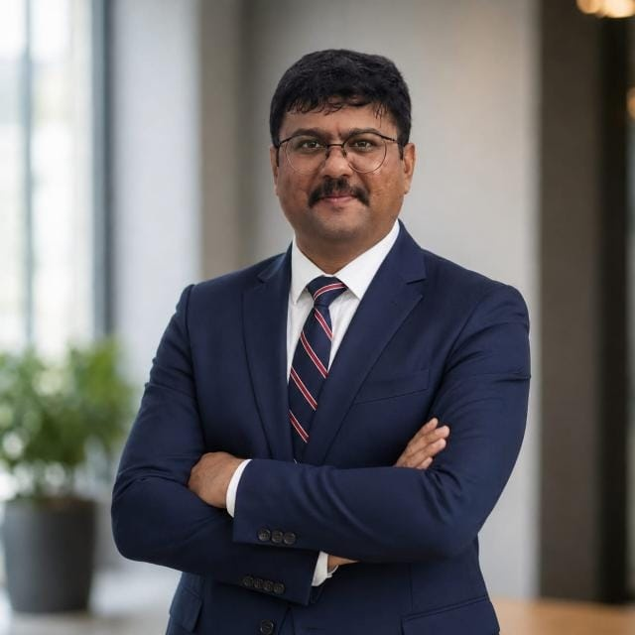
Thank you · ಧನ್ಯವಾದಗಳು
Sadanand Pattanshetty
ಸದಾನಂದ ಪಟ್ಟಣಶೆಟ್ಟಿ
Founder & CEO, Ayud Software
IT & Digital Advisor, KKCCI
10+ years in careers, placements and corporate training. Building Ayud as a Career GPS for Tier-2 India, so talent from Kalyana Karnataka doesn't have to guess its way into a career.
sadanand.p@ayudsoftware.com · +91 81237 34755
ayudjobs.com · ayudsoftware.com · Instagram @ayudjobs
NEXT Session 2 · Sun 25 Oct · 10 AM · Resume Building & Document Readiness · Bring your resume, marks cards and Aadhaar (photos on phone are fine)
Notes:
12:55 · 5 min
DO: Thank KKCCI and the office-bearers. Share helpline numbers. Ask everyone to bring one friend next week.
KEY POINTS:
- Cross the bridge to your career.
ಕನ್ನಡ: ನಿಮ್ಮ ವೃತ್ತಿಜೀವನಕ್ಕೆ ಸೇತುವೆ ದಾಟಿ.

